Slide 1

Minimum Square Meters For Development

Slide 2
Minimum Square Meters For Development
Local Town Plans / City’s Regional areas (Τοπικά Σχέδια) Limassol as example 2011 Plan 122 page.
Net indoor area (Ωφέλιμα Εμβαδά)
Studio Minimum: 30m2 (City Center) - 35m2 (Other Areas)
1 Bedroom: 45m2 (City Center) - 50m2 (Other Areas)
2 Bedroom: 65m2 (City Center) - 75m2 (Other Areas)
3 Bedroom: 85m2 (City Center) - 95m2 (Other Areas)
Student Accommodation: 30m2 (around, it depends, subject to conditions)
Example of Limassol 2011 Local Town Plan (Τοπικό Σχέδιο Λεμεσού 2011)
http://www.moi.gov.cy/moi/tph/tph.nsf/All/A4F0D9A13D96866CC22588020045C272/$file/%CE%9A%CE%B5%CE%AF%CE%BC%CE%B5%CE%BD%CE%BF%20(2011).pdf?OpenElement

Slide 3
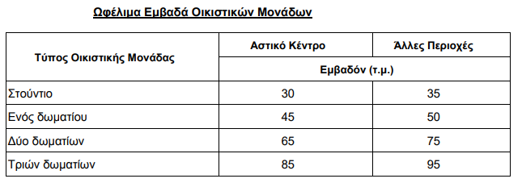
Residential Zones

Slide 4
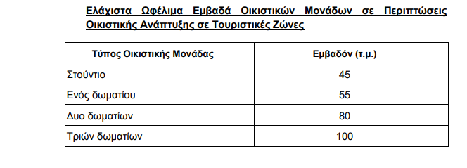
Touristic Zones

